Slide 1
SpaceX Falcon 9 First Stage Landing Prediction
Applied Data Science Capstone Project - Final Presentation
Author / Learner: alfaturachman
Course Platform: IBM Data Science Professional Certificate | Coursera
Project Scope: Applied Data Science Capstone (Modules 1 - 5)
Public GitHub Repository: https://github.com/alfaturachman/IBM-Applied-Data-Science-Capstone
Deliverables Included: Executed Jupyter Notebooks (Parts 1-5), SQLite Database, Folium Map, Plotly Dash App
Submission Date: October 2026

Slide 2
Executive Summary
End-to-End Analytics & Predictive Modeling of Falcon 9 First Stage Recovery
Project Context & Business Value
  SpaceX drastically reduces launch costs by reusing Falcon 9 first-stage boosters ($62M vs. $165M+ from expendable competitors). Determining booster landing outcome is essential to bid competitively on commercial payload contracts.
End-to-End Methodology
  Collected 90 launches via REST API and Wikipedia web scraping (BeautifulSoup); cleaned and imputed missing PayloadMass; created binary target Class (1=Success, 0=Failure); engineered 80 features via One-Hot Encoding; performed EDA using SQLite database queries and Seaborn; built geospatial maps in Folium; developed interactive dashboards in Plotly Dash; optimized 4 classification models via GridSearchCV.
Key Quantitative Findings
  All 4 classification models (Logistic Regression, SVM, Decision Tree, KNN) achieved 83.33% accuracy on the unseen 18-sample test set (15 correct predictions).
Top Launch Facility
  KSC LC-39A achieved the highest success rate (76.92%, 10 successes). Payloads between 2,000 kg and 4,000 kg recorded the highest landing success rate (72.7%).
Project Repository
  Full code, notebooks, and database available at: https://github.com/alfaturachman/IBM-Applied-Data-Science-Capstone
IBM Applied Data Science Capstone | Learner: alfaturachman | GitHub: https://github.com/alfaturachman/IBM-Applied-Data-Science-Capstone

Slide 3
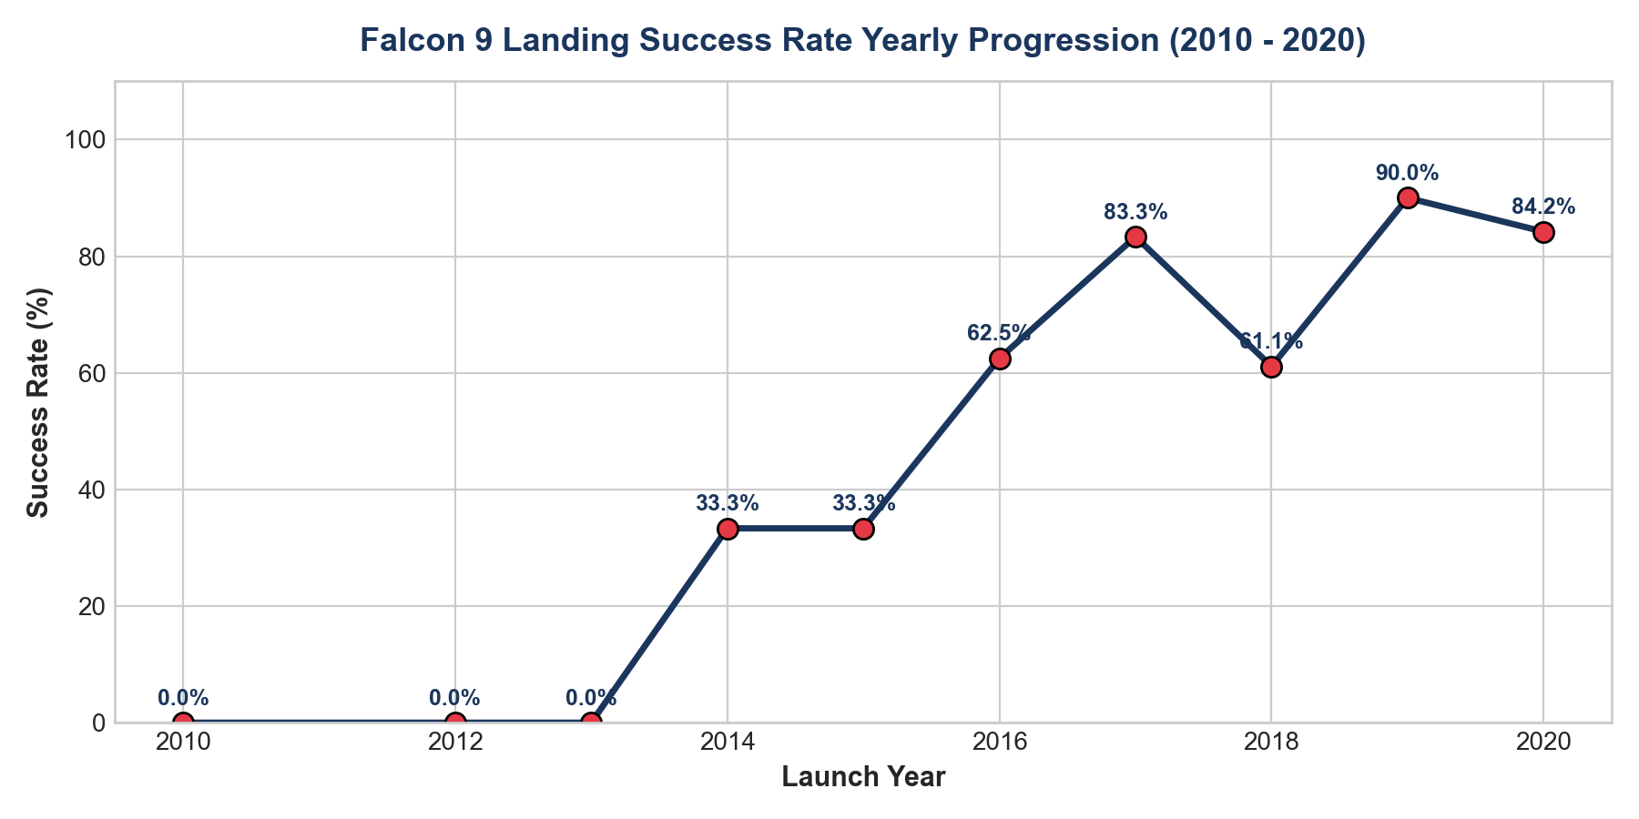
Project Introduction & Problem Statement
Commercial Background, Value Proposition, and Machine Learning Formulation
Commercial Launch Disruption
  SpaceX offers Falcon 9 commercial launches at ~$62M, saving clients over $100M compared to traditional aerospace providers.
First Stage Dominance
  Over 70% of total rocket construction cost is concentrated in the first-stage booster, including nine Merlin 1D engines and titanium grid fins.
The Business Problem
  Competing aerospace firms need to accurately estimate SpaceX's launch costs. Predicting whether the first stage will land safely determines if SpaceX achieves a $62M cost basis or absorbs an expendable launch cost.
Machine Learning Problem Formulation
  Supervised Binary Classification problem. Target variable Y is Class (1 = Successful Landing, 0 = Failed Landing). Feature matrix X contains 80 numeric attributes.
IBM Applied Data Science Capstone | Learner: alfaturachman | GitHub: https://github.com/alfaturachman/IBM-Applied-Data-Science-Capstone

Slide 4
Data Collection: SpaceX REST API Methodology
Automated API Ingestion Pipeline & Attribute Extraction
Primary API Endpoint
  Queried the official SpaceX REST API endpoint https://api.spacexdata.com/v4/launches/past using Python requests.
Filtering Criteria
  Filtered launch records strictly for Falcon 9 missions, removing early Falcon 1 test flights.
Auxiliary Endpoint Resolution
  Primary launch data contains identification hashes that required secondary API queries: /v4/rockets/ (Falcon 9 identification), /v4/payloads/ (PayloadMass and target Orbit), /v4/launchpads/ (LaunchSite coordinates), and /v4/cores/ (landing outcome, block serial, reuse count).
Ingestion Logic Flowchart
  GET /v4/launches/past -> Filter Falcon 9 -> Extract Core Hashes -> Query Secondary Endpoints -> Construct Consolidated Pandas DataFrame (90 launches).
Code Repository
  Full API extraction notebook available at: https://github.com/alfaturachman/IBM-Applied-Data-Science-Capstone
IBM Applied Data Science Capstone | Learner: alfaturachman | GitHub: https://github.com/alfaturachman/IBM-Applied-Data-Science-Capstone

Slide 5
Data Collection: Web Scraping Methodology
BeautifulSoup HTML Extraction from Wikipedia Falcon 9 Records
Data Source & Objective
  Scraped Wikipedia 'List of Falcon 9 and Falcon Heavy launches' to independently validate API records and cross-verify historical flight manifests.
Parsing Architecture
  Extracted HTML content using requests.get() and parsed Document Object Model (DOM) using BeautifulSoup(response.text, 'html.parser').
Table & Column Normalization
  Targeted HTML tables with class 'wikitable'. Extracted and cleaned canonical headers: Flight No., Date, Version Booster, Launch Site, Payload, Orbit, Customer, and Launch Outcome.
Row Extraction & Data Cleansing
  Iterated through <tr> rows, stripped footnote reference tags (e.g., [1], [2]), stripped whitespace, and parsed payload mass in kilograms into numerical floats.
Code Repository
  Full scraping notebook available at: https://github.com/alfaturachman/IBM-Applied-Data-Science-Capstone
IBM Applied Data Science Capstone | Learner: alfaturachman | GitHub: https://github.com/alfaturachman/IBM-Applied-Data-Science-Capstone

Slide 6
Data Wrangling Methodology
Data Cleaning, Imputation, Target Label Encoding, and Feature Matrix Generation
Handling Missing Data (PayloadMass)
  Identified missing values in PayloadMass for classified government flights. Applied statistical mean imputation: df['PayloadMass'].fillna(df['PayloadMass'].mean(), inplace=True).
Creation of Binary Target Variable (Class)
  Parsed landing Outcome text strings (True Ocean, False Ocean, True RTLS, False RTLS, True ASDS, False ASDS, None). Mapped successful recoveries to Class = 1, and failures/unattempted to Class = 0.
Target Distribution
  Resulted in 90 total launches: 60 successful landings (66.7%) and 30 failed landings (33.3%).
One-Hot Encoding for Categorical Features
  Transformed Orbit (11 categories), LaunchSite (3 categories), LandingPad (5 categories), and Serial (53 categories) using pd.get_dummies(), yielding an 80-feature numerical matrix (dataset_part_3.csv).
Code Repository
  Full wrangling notebook available at: https://github.com/alfaturachman/IBM-Applied-Data-Science-Capstone
IBM Applied Data Science Capstone | Learner: alfaturachman | GitHub: https://github.com/alfaturachman/IBM-Applied-Data-Science-Capstone

Slide 7
EDA and Data Visualization Methodology
Visual Exploration Framework using Seaborn & Matplotlib
Visual Exploration Goals
  Identified decision boundaries, evaluated feature correlations, and detected operational patterns across 90 SpaceX missions.
Flight Number vs. Payload Mass (Scatter Plot)
  Tested whether SpaceX's landing success rate improved over time (higher flight numbers) and examined the impact of heavy payloads.
Launch Site vs. Payload Mass (Categorical Scatter)
  Analyzed launch facility specialization and payload capacities across CCAFS, KSC, and VAFB.
Success Rate by Orbit Type (Bar Chart)
  Evaluated recovery rates across diverse orbital trajectories (LEO, GTO, SSO, ISS, Polar, VLEO).
Annual Success Progression Trend (Line Plot)
  Tracked the annual learning curve and hardware maturation of the Falcon 9 booster from 2010 to 2020.
Code Repository
  Full visualization script available at: https://github.com/alfaturachman/IBM-Applied-Data-Science-Capstone
IBM Applied Data Science Capstone | Learner: alfaturachman | GitHub: https://github.com/alfaturachman/IBM-Applied-Data-Science-Capstone

Slide 8
EDA with SQL Methodology
Database Architecture, Schema Setup, and Relational Querying
Database Environment
  Loaded the cleaned SpaceX dataset into an embedded SQLite database (my_data1.db) using sqlite3 and the %sql IPython extension.
Table Schema Setup
  Configured table SPACEXTBL with appropriate data types for Date, Booster_Version, Launch_Site, Payload, PAYLOAD_MASS__KG_, Orbit, Customer, Mission_Outcome, and Landing_Outcome.
Core SQL Queries Executed
  1. Distinct launch sites (SELECT DISTINCT Launch_Site). 2. NASA payload accumulation (SUM(PAYLOAD_MASS__KG_) WHERE Customer='NASA (CRS)'). 3. Average payload mass for successful landings (AVG). 4. First ground pad landing date (MIN(Date) WHERE Landing_Outcome='Success (ground pad)'). 5. Drone ship successes between 4,000-6,000 kg. 6. Maximum payload boosters.
Code Repository
  Full SQL queries and database available at: https://github.com/alfaturachman/IBM-Applied-Data-Science-Capstone
IBM Applied Data Science Capstone | Learner: alfaturachman | GitHub: https://github.com/alfaturachman/IBM-Applied-Data-Science-Capstone

Slide 9
Interactive Visual Analytics Methodology
Geospatial Folium Mapping & Reactive Plotly Dash Web Application Architecture
Folium Geospatial Mapping Framework
  Built Leaflet.js-based interactive maps centered on US launch facilities. Added 1,000-meter safety radius circles (folium.Circle) and clustered launch outcomes (MarkerCluster) with green/red markers.
Haversine Proximity Calculations
  Calculated spherical geodetic distances from launch pads to coastlines, highways, railways, and cities, visualizing proximity lines via folium.PolyLine.
Plotly Dash Web Application Framework
  Constructed reactive Python web application with dcc.Dropdown (ALL sites vs. specific site) and dcc.RangeSlider (payload mass 0 - 10,000 kg).
Reactive Callbacks
  Configured @app.callback routines to dynamically update px.pie (success counts/ratios) and px.scatter (payload vs outcome colored by booster category).
Code Repository
  Application script spacex_dash_app.py available at: https://github.com/alfaturachman/IBM-Applied-Data-Science-Capstone
IBM Applied Data Science Capstone | Learner: alfaturachman | GitHub: https://github.com/alfaturachman/IBM-Applied-Data-Science-Capstone

Slide 10
Predictive Analysis (Classification) Methodology
Feature Standardization, Train-Test Partitioning, Cross-Validation, and Hyperparameter Tuning
Feature Scaling (StandardScaler)
  Transformed the 80-feature matrix using StandardScaler (z = (x - mean)/std) to ensure scale-sensitive algorithms (SVM, KNN, Logistic Regression) converge without feature bias.
Data Splitting
  Partitioned dataset using train_test_split(X, Y, test_size=0.2, random_state=2), yielding exactly 72 training samples and 18 test samples.
Cross-Validation & Grid Search
  Applied 10-fold cross-validation (cv=10) with GridSearchCV to tune hyperparameters: Logistic Regression (C, penalty, solver), SVM (kernel, C, gamma), Decision Tree (criterion, max_depth, splitter, min_samples_split), and KNN (n_neighbors, p, algorithm).
Code Repository
  Full predictive notebook available at: https://github.com/alfaturachman/IBM-Applied-Data-Science-Capstone
IBM Applied Data Science Capstone | Learner: alfaturachman | GitHub: https://github.com/alfaturachman/IBM-Applied-Data-Science-Capstone

Slide 11
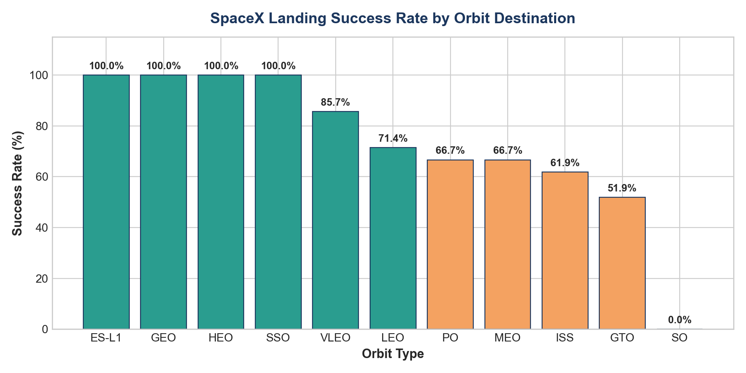
EDA with Visualization Results
Empirical Patterns Across Flight Numbers, Payload Classes, and Orbital Targets
Flight Number vs. Success
  Early flights (1-25) had high failure rates during initial rocket development. After flight #40, success rates consistently exceeded 80%.
Payload Mass Impact
  In the heavy payload range (>8,000 kg), launches were primarily to LEO (e.g., Starlink) with near-perfect landing recovery rates.
Orbit-Specific Success Rates
  100% Success: ES-L1, GEO, HEO, SSO. Moderate Success: VLEO (~85%), LEO (~71%), ISS (~62%). Challenging: GTO (~52%) due to severe re-entry thermal loads.
Annual Trend
  Success rate progressed from 0% in 2010 to >80% in 2020, demonstrating rapid hardware maturation.
IBM Applied Data Science Capstone | Learner: alfaturachman | GitHub: https://github.com/alfaturachman/IBM-Applied-Data-Science-Capstone

Slide 12
EDA with SQL Results
Quantitative Database Extraction Findings on Launch Sites, Payloads, and Boosters
Distinct Launch Sites
  Exactly 4 launch sites identified: CCAFS LC-40, CCAFS SLC-40, KSC LC-39A, and VAFB SLC-4E.
NASA Cumulative Payload
  Total payload mass delivered for NASA (CRS) missions: 45,596 kg.
Average Successful Payload
  Average payload mass for successful landings: 5,408 kg.
First Ground Pad Recovery
  Earliest successful ground landing occurred on 2015-12-22 (Booster B1019 at LZ-1).
Successful Drone Ship Boosters (4,000 - 6,000 kg)
  Boosters B1022.1, B1026.1, B1021.2, and B1031.2 successfully landed on drone ships within this payload bracket.
Maximum Payload Boosters
  Maximum payload mass: 15,600 kg (delivered by Block 5 boosters B1048.4, B1049.4, B1051.3, B1056.4 for Starlink missions).
IBM Applied Data Science Capstone | Learner: alfaturachman | GitHub: https://github.com/alfaturachman/IBM-Applied-Data-Science-Capstone

Slide 13
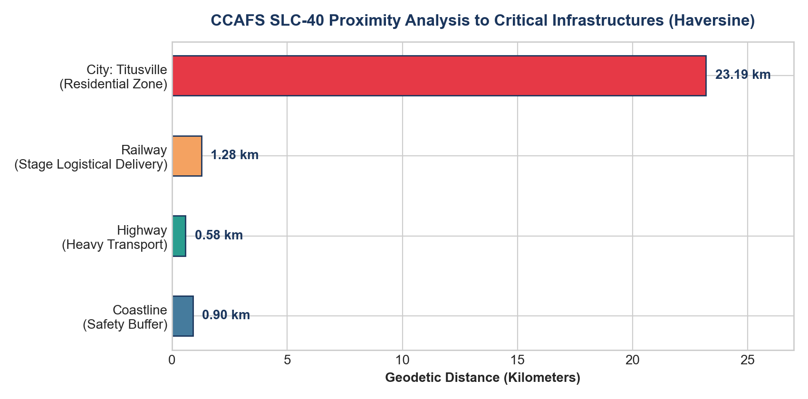
Interactive Map Results using Folium
Geospatial Distribution, Outcome Clustering, and Infrastructure Proximity Analysis
Coastal Placement Strategy
  All launch sites are positioned directly on coastlines (Florida Atlantic coast, California Pacific coast) to ensure launch trajectories fly over water, minimizing public hazard.
Proximity Analysis for CCAFS SLC-40
  Distance to Coastline: 0.90 km (direct ocean buffer).
  Distance to Highway: 0.58 km (oversize rocket stage transport).
  Distance to Railway: 1.28 km (heavy propellant and hardware delivery).
  Distance to Nearest City (Titusville): 23.19 km (ensures safe perimeter >20 km).
Marker Clustering
  MarkerCluster visualizes high success density at KSC LC-39A compared to older Cape Canaveral pads.
IBM Applied Data Science Capstone | Learner: alfaturachman | GitHub: https://github.com/alfaturachman/IBM-Applied-Data-Science-Capstone

Slide 14
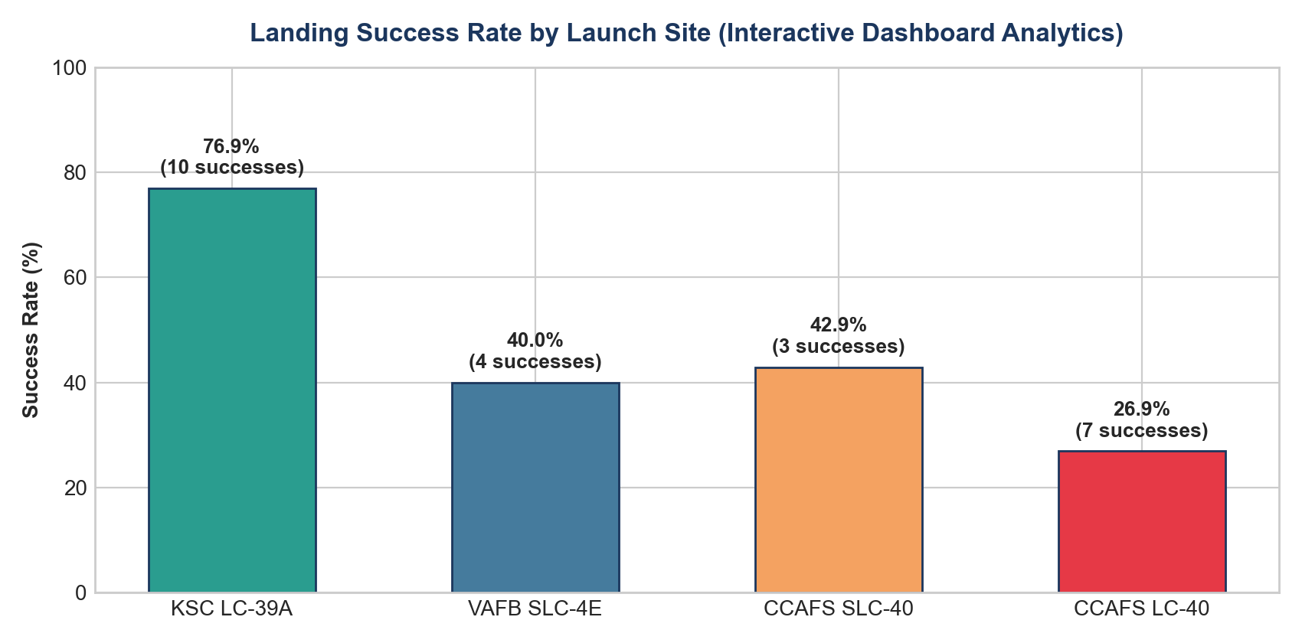
Plotly Dash Dashboard Results
Dynamic Success Proportions, Launch Site Superiority, and Payload Thresholds
Most Successful Launch Site
  KSC LC-39A leads with 10 successful landings (41.7% of all successes) and the highest overall success rate of 76.92%.
Site Ranking by Success Rate
  KSC LC-39A (76.92%) > CCAFS SLC-40 (42.86%) > VAFB SLC-4E (40.00%) > CCAFS LC-40 (26.92%).
Payload Sweet Spot
  Payloads between 2,000 kg and 4,000 kg recorded the highest success rate at 72.7%.
Most Vulnerable Payload Range
  Payloads between 6,000 kg and 8,000 kg recorded a 0% landing success rate (0 of 4 launches succeeded).
Booster Evolution
  Booster Block 5 (B5) achieved a 100% success rate, proving the reliability of reusable heat shielding.
IBM Applied Data Science Capstone | Learner: alfaturachman | GitHub: https://github.com/alfaturachman/IBM-Applied-Data-Science-Capstone

Slide 15
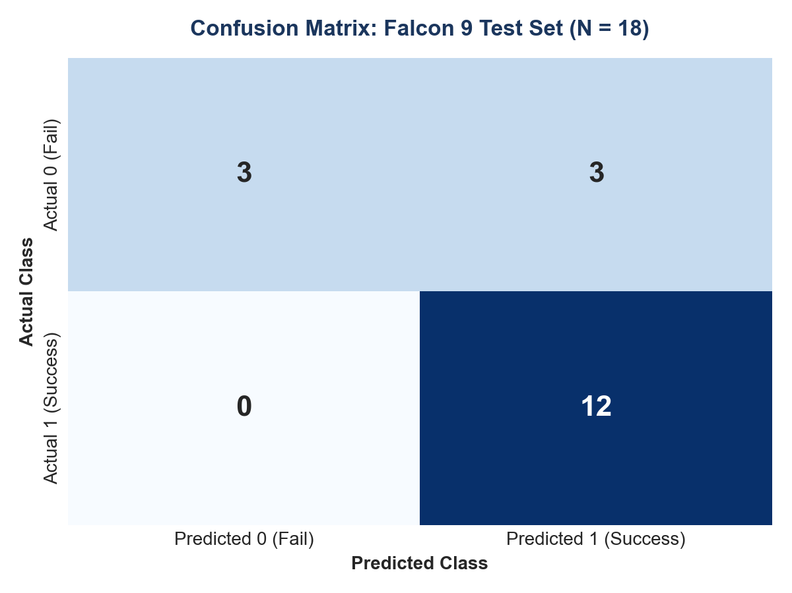
Predictive Analysis (Classification) Results
Model Evaluation Metrics, Confusion Matrix Breakdown, and Optimal Model Selection
Model Accuracy Evaluation
  All four tuned models achieved an identical test accuracy of 83.33% on the 18 unseen test samples (15 correct predictions out of 18).
Optimal Hyperparameters
  Logistic Regression: C=0.01, penalty='l2'. SVM: kernel='sigmoid', C=1.0, gamma=0.0316. Decision Tree: criterion='entropy', max_depth=8. KNN: n_neighbors=5, p=1.
Confusion Matrix Breakdown (N = 18)
  True Positives (TP): 12 | True Negatives (TN): 3
  False Positives (FP): 3 | False Negatives (FN): 0
Model Recommendation
  Logistic Regression is recommended for production deployment due to high computational efficiency, interpretability, and smooth probability calibration.
IBM Applied Data Science Capstone | Learner: alfaturachman | GitHub: https://github.com/alfaturachman/IBM-Applied-Data-Science-Capstone

Slide 16
Conclusion & Strategic Business Recommendations
Actionable Takeaways for Aerospace Competitors Bidding Against SpaceX
Predictive Feasibility
  Machine learning classification reliably predicts Falcon 9 booster recovery with 83.33% accuracy, allowing aerospace competitors to forecast SpaceX's marginal launch costs.
Operational Risk Profile
  Heavy payloads (>6,000 kg) to GTO orbits represent high-risk missions where booster re-entry thermal loads prevent recovery. Competitors can bid aggressively on these missions because SpaceX will likely expend hardware.
Launch Site Selection
  KSC LC-39A demonstrates superior operational maturity (76.92% success), while CCAFS SLC-40 exhibits higher landing volatility (42.86%).
Competitive Bidding Guidance
  When competing for LEO / smallsat constellations (2,000 - 4,000 kg), expect SpaceX to bid at $62M due to a >72% landing probability. For heavy GTO flights, price bids assuming SpaceX incurs expendable booster costs ($100M+).
IBM Applied Data Science Capstone | Learner: alfaturachman | GitHub: https://github.com/alfaturachman/IBM-Applied-Data-Science-Capstone

Slide 17
Innovative Insights & Future Technical Roadmap
Financial Impact of Misclassifications, Class Rebalancing, and Enterprise Scalability
Asymmetric Financial Impact of Errors
  Zero False Negatives (FN = 0) ensures sea recovery assets (drone ships, tugboats) are never omitted when a booster lands. However, 3 False Positives (FP = 3) incur ~$200K-$500K in unnecessary sea deployment expenses for unrecovered hardware.
Class Imbalance Remediation
  Because successful landings constitute 66.7% of historical data, models naturally bias toward predicting success. Applying SMOTE (Synthetic Minority Over-sampling Technique) or cost-sensitive class weighting will penalize False Positives and improve sensitivity to high-risk flight parameters.
Creative Presentation Architecture
  Constructed a unified design system with high-contrast data visualizations, geodetic proximity metrics, and full open-source reproducibility.
Project Code Repository
  Full codebase and notebooks available at: https://github.com/alfaturachman/IBM-Applied-Data-Science-Capstone
IBM Applied Data Science Capstone | Learner: alfaturachman | GitHub: https://github.com/alfaturachman/IBM-Applied-Data-Science-Capstone

